Slide 1

Web Development Services in Pakistan
Learn Web Development Welcome to the MDN Web Development Learning Zone (also known as the Learning Zone). Here we provide a set of structured tutorials to help you master the core skills and practices needed to become a successful front-end developer, while also offering several challenges and recommended advanced resources.
Error! Hyperlink reference not valid.: Providing core skills and knowledge to all front-end developers to help them achieve professional success and become valuable developers in the industry, as defined in the MDN curriculum.
The Learning Zone content is created by the MDN community and continuously optimized with suggestions from students, instructors, and the wider web community.
The Learning Zone aims to help you transition from "newbie" to "comfort" (rather than "newbie" to "expert") and teach you how to utilize further resources (such as other MDN content).
Not sure where to start?
Never programmed before?

Slide 2
Our Getting Started module provides setup tutorials and basic concepts and background knowledge for complete beginners. If you have absolutely no programming experience (e.g., haven't installed a code editor or written any code yet), we recommend starting here.
Want to master the core content?
Our Core module provides a structured tutorial to help you master the core skills and practices needed to become a Error! Hyperlink reference not valid.
Error! Hyperlink reference not valid.
Our Extension modules cover useful skills you need to learn as you expand your knowledge and develop your expertise. You can continue learning these after completing the Core module.
Working in a school?
You can use our modules to guide your teaching and visit the Instructor page for more ideas.
Test Your Skills
Throughout the course, you'll encounter several articles designed to help you assess your learning. There are two main t
"Skill Test" articles appear more frequently, primarily testing your mastery of a single knowledge point (such as HTML links, the CSS box model, or JavaScript functions).
"Challenges" appear less frequently, primarily testing your ability to combine multiple knowledge points to complete a website or program.
Most questions include HTML/CSS/JavaScript code blocks, showing the starting code for each task. We recommend clicking the "Play" button in the code block to open the example in the MDN Playground, and t

Slide 3
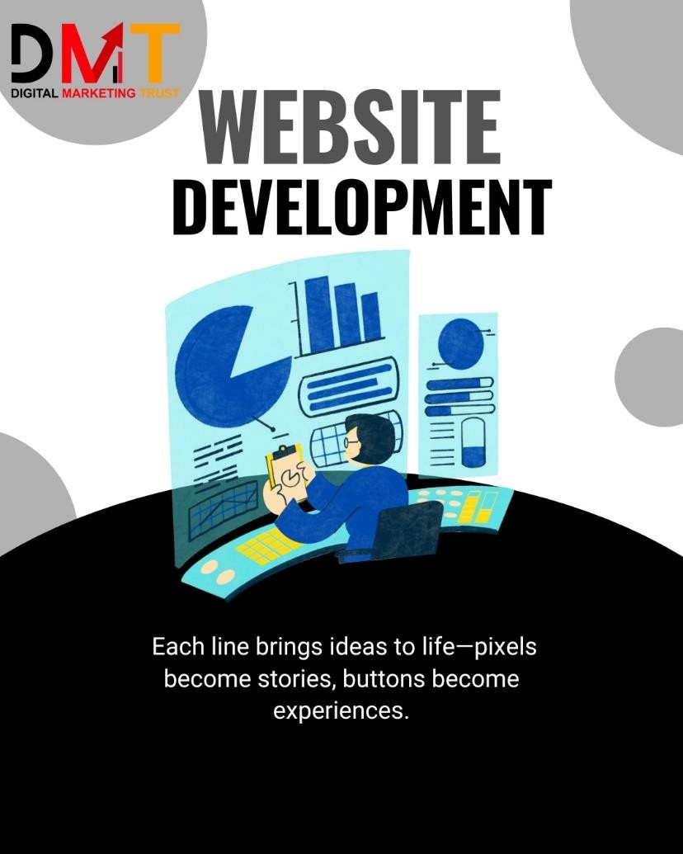
If you make a mistake, you can use the Playground's reset button to clear your work. If you get stuck, you can usually find the reference answer at the bottom of each question, or contact us.
Some questions don't provide a starting code block; instead, they ask you to download a starting file and complete the task locally. This is usually because the question is complex, or we want you to practice in a different way.
Get Our Code Examples
All the code examples you encounter in the learning area are hosted on GitHub:
The easiest way is to download the latest main branch ZIP archive.
If you are familiar with Git and GitHub, you can also choose to clone the repository.

